Slide 1
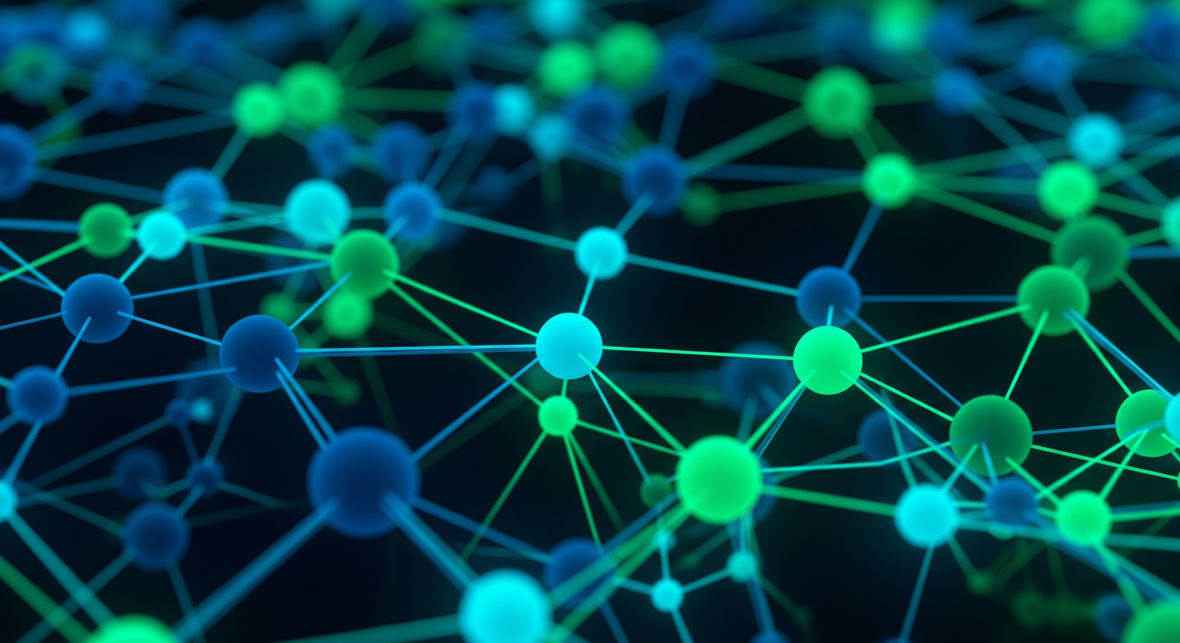
BSIDES SOUTH FLORIDA · TECH TALK
From Prompt
to Pipeline.
How the Dual-Agent Method Automates Cloud Security Remediation
Dual-Agent
pipeline_demos
Sara Costa
Founder · Papaya Kiwi Consulting LLC
papaya.kiwi
papaya.kiwi · @PapayaKiwiSOC · BSides South Florida
01 / 14

Slide 2

THE PROBLEM
Most security tools tell you what's wrong.
Few tell you what to do.
Almost none do it for you.
DETECT
Cloud events ingested
ANALYZE
LLM processes findings
NARRATE
Attack timeline generated
?
"What would you like to do now?"
Papaya + Kiwi · papaya.kiwi · @PapayaKiwiSOC · BSides South Florida
Papaya + Kiwi · papaya.kiwi · @PapayaKiwiSOC · BSides South Florida
02 / 14
02 / 14

Slide 3

THE DUAL-AGENT METHOD
Two agents. One closed loop.
PAPAYA
KIWI
Advisory Agent
Scanner + Executor
▸ Listens to your natural language prompt
▸ Understands what you want to scan or fix
▸ Suggests which workflow to run
▸ Translates findings into plain language
▸ Structures a validated JSON handoff
▸ Ingests the JSON handoff from Papaya
▸ Dispatches the selected GitHub Actions workflow
▸ Runs the scan against your repo or image
▸ Executes Terraform plan + apply
▸ Confirms and logs every action taken
JSON
Papaya + Kiwi · papaya.kiwi · @PapayaKiwiSOC · BSides South Florida
03 / 14

Slide 4

STEP 1 · YOU TYPE A PROMPT
It starts with a sentence.
papaya-kiwi — bash
> "scan this container image and remediate any critical CVEs"
→ Papaya recognizes: Docker image scan + fix
> "check my Terraform for misconfigurations"
→ Papaya recognizes: Checkov IaC scan
> "run a cloud compliance check on my AWS account"
→ Papaya recognizes: Prowler CIS benchmark
Papaya + Kiwi · papaya.kiwi · @PapayaKiwiSOC · BSides South Florida
04 / 14

Slide 5
STEP 2 · PAPAYA INTERPRETS + SUGGESTS
Papaya asks. You confirm.
papaya-kiwi — bash
>
scan this container image and remediate any critical CVEs
PAPAYA
Got it — scanning a container image for critical CVEs.
I'd suggest running the Docker Image Scan workflow.
It uses Trivy to check for vulnerabilities in your image.
PAPAYA
Which workflow should Kiwi run?
[1]
Docker Image Scan.yml ← recommended for this prompt
[2]
checkov.yml ← IaC / Terraform policy scan
[3]
prowler.yml ← AWS cloud compliance check
>
1
PAPAYA
Confirmed. Handing off to Kiwi → Docker Image Scan.yml
Papaya + Kiwi · papaya.kiwi · @PapayaKiwiSOC · BSides South Florida
05 / 14

Slide 6
THE WORKFLOWS · .GITHUB/WORKFLOWS/
Three real GitHub Actions.
Kiwi knows how to run all of them.
Docker Image Scan.yml
Trivy
checkov.yml
Checkov
prowler.yml
Prowler
Push to main or manual dispatch
Push to /tf or manual dispatch
Scheduled or manual dispatch
·Container image CVE scan
·Trivy · severity-ranked findings
·Findings JSON artifact output
·Auto-patches CRITICAL CVEs
·Scans /tf Terraform directory
·CIS + custom policy evaluation
·Flags misconfigs before apply
·Kiwi runs terraform plan on pass
·GitHub OIDC auth (no stored keys)
·CIS AWS Foundations benchmark
·Findings per account + region
·Kiwi queues remediation plays
repo: github.com/papaya-kiwi/pipeline_demos · all workflows already committed
Papaya + Kiwi · papaya.kiwi · @PapayaKiwiSOC · BSides South Florida
06 / 14

Slide 7
STEP 3 · KIWI EXECUTES
Kiwi doesn't suggest. Kiwi ships.
01
Receives JSON handoff
schema validated · workflow identified
02
Dispatches workflow
POST /repos/{owner}/{repo}/actions/...
03
Monitors run status
polls GitHub API · streams logs
04
Retrieves findings JSON
papaya-kiwi-scan-report.json
05
Executes Terraform plan
dry-run first · human-gated
06
Confirms + audit logs
3/3 actions confirmed · loop closed
Papaya + Kiwi · papaya.kiwi · @PapayaKiwiSOC · BSides South Florida
07 / 14

Slide 8
THREAT RESPONSE SIMULATION · TERMINAL SESSION
From Prompt to Resolution.
papaya-kiwi — bash
> scan this container image and remediate any critical CVEs
PAPAYA: Got it. Running Docker Image Scan.yml via Kiwi.
KIWI: Dispatching workflow · workflow_id: 12849237
[SCAN] Trivy: scanning papaya-kiwi/api:latest
[CVE] CRITICAL CVE-2024-1234 openssl 3.0.2 → fixed in 3.0.7
[CVE] CRITICAL CVE-2024-5678 libssl → no fix available
[CVE] HIGH CVE-2023-9999 curl → fixed in 8.4.0
PAPAYA: Two critical CVEs found. Say 'remediate' to patch openssl.
> remediate
KIWI: Executing: update base image → openssl 3.0.7
KIWI: ✓ CRITICAL CVE-2024-1234 resolved · image pushed
KIWI: Remediation complete · 1/1 actionable CVEs resolved
Papaya + Kiwi · papaya.kiwi · @PapayaKiwiSOC · BSides South Florida
08 / 14

Slide 9
WHAT MAKES IT WORK · THE HANDOFF SCHEMA
Free-form text is a finding.
Validated JSON is a handoff.
WITHOUT A SCHEMA
WITH HANDOFF SCHEMA
✗ Agent generates free-form text
✗ Another agent tries to parse it
✗ No guaranteed structure
✗ Cannot be validated or audited
✗ "What would you like to do now?"
{ "agent_source": "papaya",
"agent_target": "kiwi",
"workflow": "Docker Image Scan",
"severity": "CRITICAL",
"auto_approved": true,
"requires_human": false }
patent-pending architecture · Patent App. No. 64/022,497
Papaya + Kiwi · papaya.kiwi · @PapayaKiwiSOC · BSides South Florida
09 / 14

Slide 10
THE ARCHITECTURE · END TO END
Prompt → Advise → Execute → Confirm.
YOUR PROMPT
PAPAYA
JSON HANDOFF
KIWI
GITHUB ACTIONS
"scan this image and fix critical CVEs"
Interprets intent
Suggests workflow
Builds JSON handoff
Validated schema
agent_source · kiwi
workflow · CVE scan
Dispatches workflow
Monitors run
Retrieves results
Docker Image Scan
Checkov · Prowler
security-scan.yml
→
→
→
→
↻ CONFIRM:
Kiwi confirms actions · audit log generated · loop closed · Papaya notifies
Papaya + Kiwi · papaya.kiwi · @PapayaKiwiSOC · BSides South Florida
10 / 14

Slide 11
THE CLOSED LOOP · 8 STEPS
Detect → Advise → Remediate → Confirm.
01
You type a prompt
02
Papaya interprets + suggests workflow
PAPAYA
PAPAYA
03
JSON handoff schema fires
04
Kiwi dispatches GitHub Actions workflow
SCHEMA
KIWI
05
Pipeline runs scan + returns findings
06
Papaya translates findings
KIWI
PAPAYA
07
Kiwi executes remediation
08
Confirm · log · loop closed
KIWI
KIWI
Papaya + Kiwi · papaya.kiwi · @PapayaKiwiSOC · BSides South Florida
11 / 14

Slide 12
OPEN SOURCE · PIPELINE_DEMOS
Clone it. Run it. Break it.
papaya.md: Papaya agent system prompt — advisory personality
pipeline_demos/
.github/workflows/
Docker Image Scan.yml
checkov.yml
prowler.yml
tf/
main.tf
papaya.md
kiwi.md
tools.py
orchestrator.py
report.py
Dockerfile
requirements.txt
README.md
kiwi.md: Kiwi agent system prompt — scanner + executor
tools.py: Anthropic tool-use API + GitHub Actions API calls
orchestrator.py: CLI runner — --mock / --rehearsal / --live modes
Docker Image Scan.yml: Trivy container CVE scan workflow
checkov.yml: Terraform IaC policy scan workflow
prowler.yml: AWS CIS compliance workflow (OIDC auth, no keys)
Real Anthropic tool-use agent loops — not text generation
Papaya + Kiwi · papaya.kiwi · @PapayaKiwiSOC · BSides South Florida
12 / 14

Slide 13
WHY THIS MATTERS
The gap between finding and fix is where breaches live.
THE PROBLEM
Security tools generate findings at machine speed. Remediation still requires manual routing, ticket creation, and human execution — a window that attackers exploit.
THE BRIDGE
The JSON inter-agent handoff schema is what makes automated remediation safe: structured, validated, auditable. Free-form text is a finding. A schema is an instruction.
THE LOOP
Kiwi + Papaya form a closed loop from prompt to pipeline: you describe the problem in plain English, Papaya suggests the right workflow, Kiwi runs it and reports back.
Papaya + Kiwi · papaya.kiwi · @PapayaKiwiSOC · BSides South Florida
13 / 14

Slide 14
Teaching security,
one sweet byte at a time.
→ github.com/papaya-kiwi/
pipeline_demos
→ papaya.kiwi
→ @PapayaKiwiSOC
→ patent-pending · 64/022,497
#CNAPP · #CloudSecurity · #DualAgent · #WomenInCyber · #PapayaKiwi
Papaya Kiwi Consulting LLC · Sarasota, FL · BSides South Florida
Papaya + Kiwi · papaya.kiwi · @PapayaKiwiSOC · BSides South Florida
14 / 14

